Slide 1
SDP PROJECT
PRESENTATION
Pearl Patel
-IT112

Slide 2
TABLE OF CONTENTS
01
04
About the Project
Sneak Peek
02
05
Major Requirements
Project Stages
03
Project Goals
Movie Recommender System –
FSD + ML
A peek at how our website would look like
Movie Datasets, User Info & Third Party Movie Database
3 Major Stages of projects
Personalization, Engagement, Accuracy and Scalability

Slide 3
MOVIE RECOMMENDATION SYSTEM
The Movie Recommendation System is designed to revolutionize user engagement by delivering personalized movie suggestions based on individual preferences and viewing history.

Slide 4
MAJOR REQUIREMENTS
MOVIE DATASET
USER EXPERIENCE
USER INFORMATION
Comprehensive dataset of movies having enough attributes to analyze similarities between movies
An intuitive and responsive React-based frontend for a seamless user experience.
To deliver personalized experience.

Slide 5
TOOLS
REACTJS(FRONTEND)
PYTHON & ITS LIBRARIES
DJANGO/FLASK

Slide 6
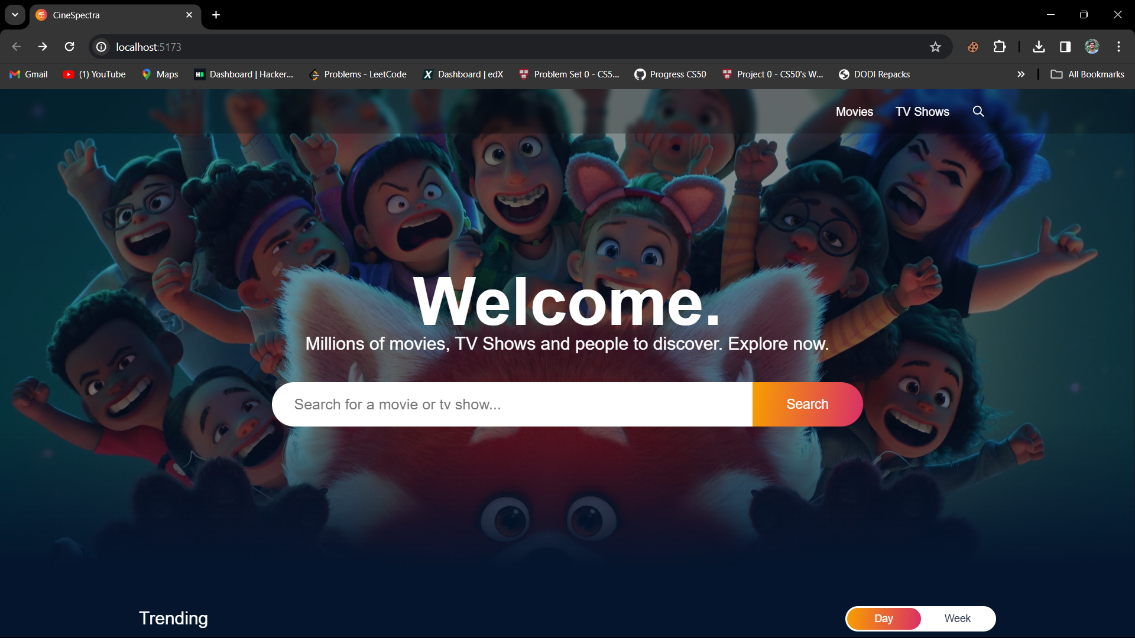
SNEAK PEEK

Slide 7
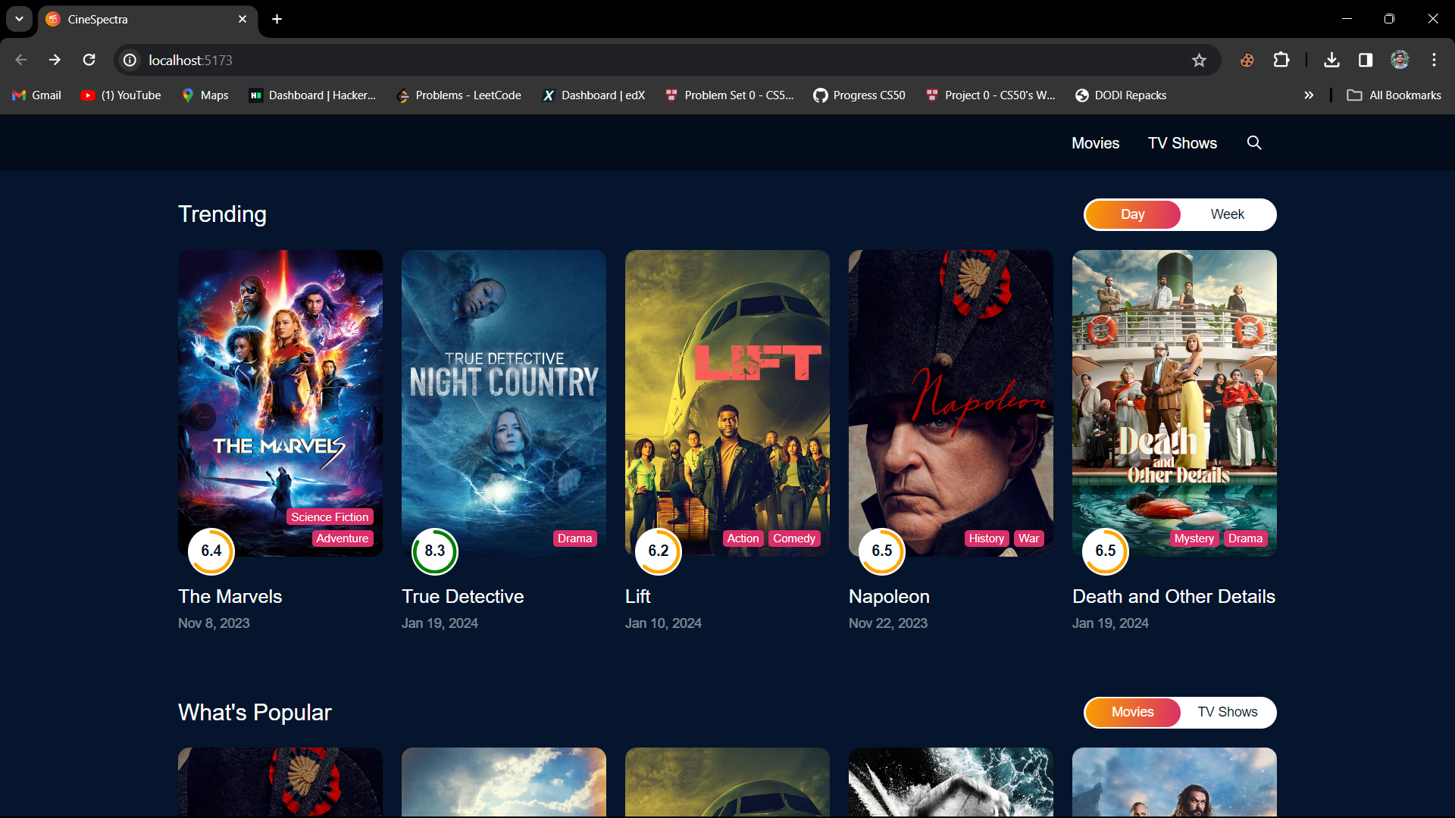

Slide 8
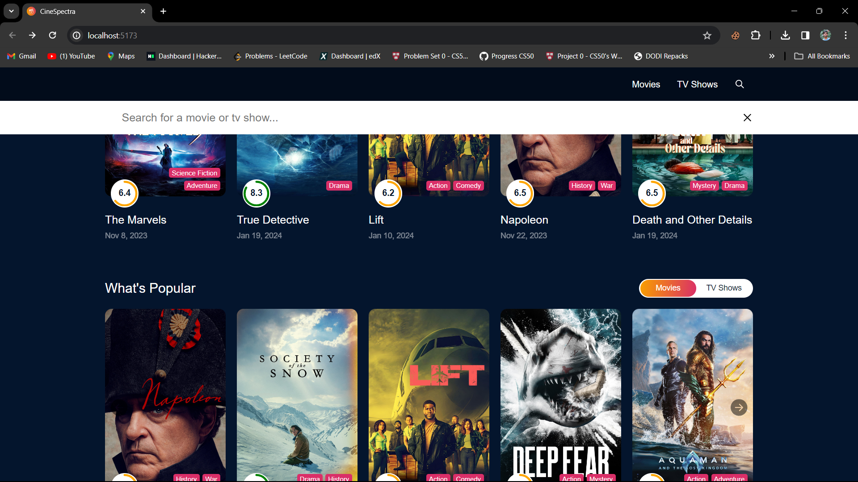

Slide 9
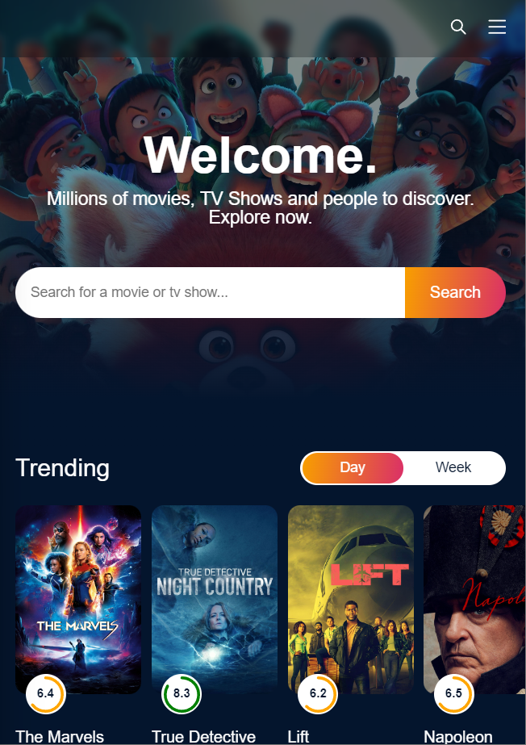
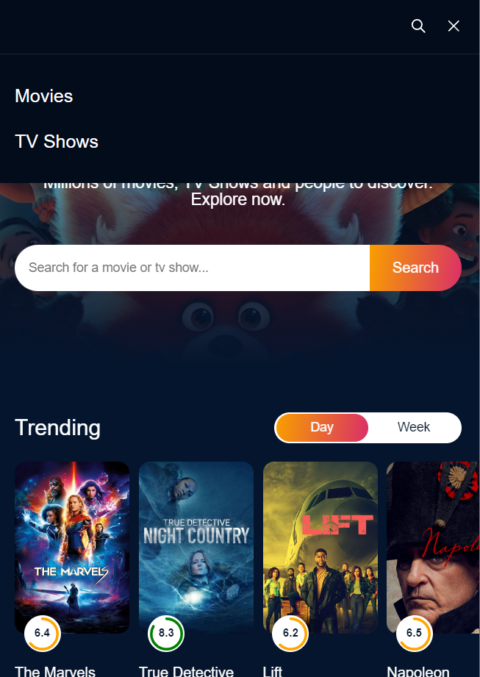
MOBILE VIEW

Slide 10
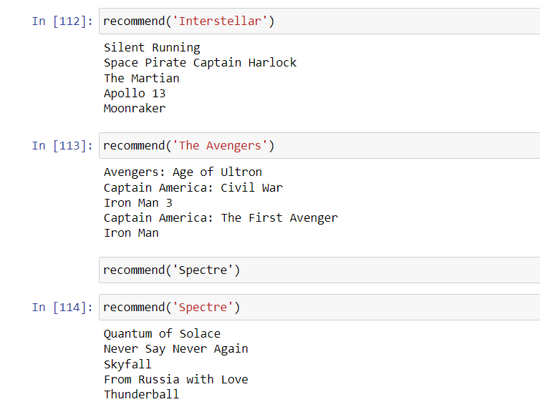
RECOMMEND FUNCTION

Slide 11
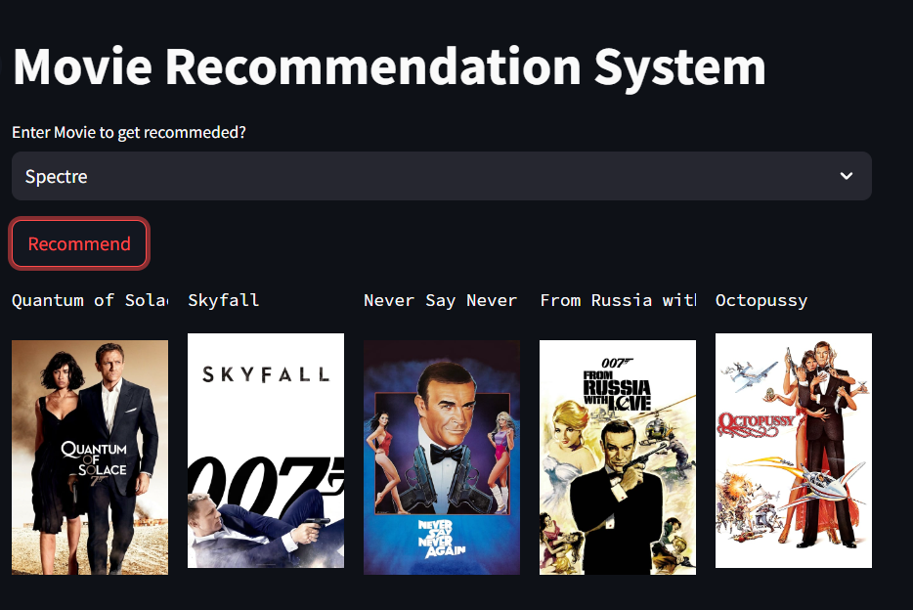
DEMO CREATED USING STREAMLIT

Slide 12
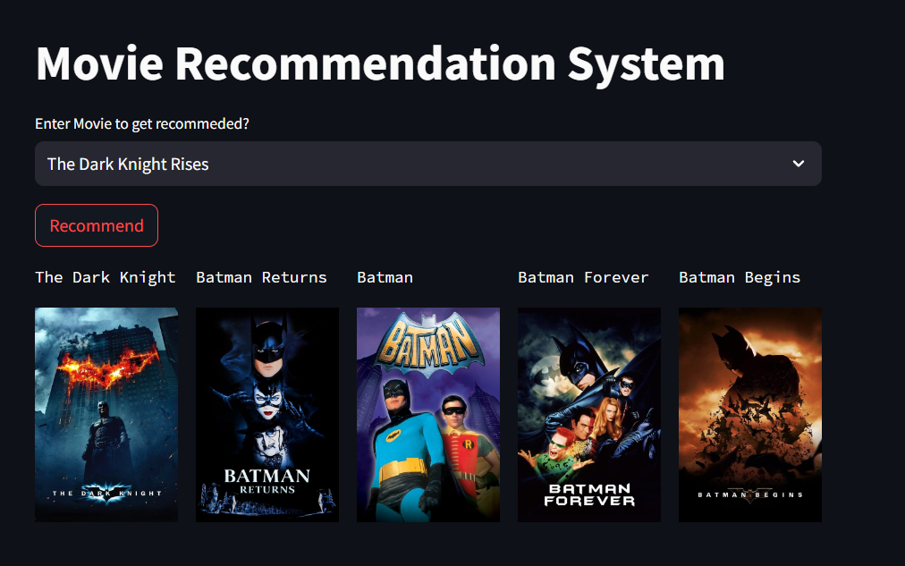

Slide 13
PROJECT STAGES
STEP 2
STEP 1
STEP 3
Implement movie recommendation algorithm using Python libraries along with dataset analysis
Create a single page React Application that can show details of movies(Frontend)
Combine both Frontend(ReactJS) and Backend(Python)

Slide 14
OUR TIMELINE
CREATING REACTJS APP
IMPLEMENT COLLABORATIVE FILTERING
LEARNING TECHNOLOGIES
FINAL
PROJECT
BUILDING MODEL(CONTENT-BASED)
USE MODEL TO SHOW RECOMMENDATION
HomePage Completed
Trained model using 5000 movies dataset
Combine frontend and backend

Slide 15
RESOURCES
CAMPUSX - YT
KAGGLE
RESEARCH PAPER - IJARIE

Slide 16
THANKS!

